Slide 1

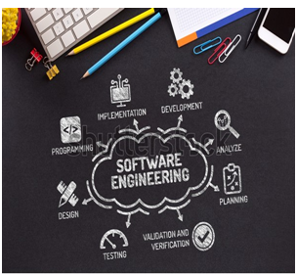

BCAC0010: System Design & Software Engineering
Class Presentations on Introduction to System Design & Software Engineering

Slide 2

SDLC Models
There are various software development life cycle models defined and designed which are followed during the software development process. These models are also referred as Software Development Process Models". Each process model follows a Series of steps unique to its type to ensure success in the process of software development.
Following are the most important and popular SDLC models followed in the industry −
Waterfall Model
Iterative Model
Spiral Model

Slide 3
Waterfall Model or Linear Sequential Model:-
The simplest oldest and most widely used process model for software development is the waterfall model.
This model acquires its name from the fact that classic software life cycle is represented as a sequence of descending steps.

Slide 4
Phases of Waterfall model:-
1) Requirement analysis and specifications.
2) System design
3) Coding
4)Testing and integration
5) Implementation and maintenance support

Slide 5
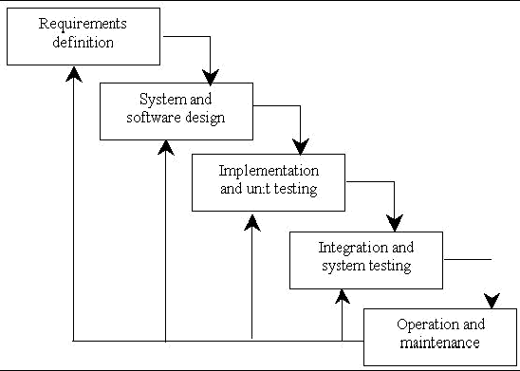

Slide 6

Requirement analysis and specifications:-
The goal of this phase is to understand the exact requirements of the customer and to document them properly.
The resultant document is known as software requirement specification document.
In this activity requirement analysis starts with the collection of all relevant data regarding the product form the users through interviews and discussion.

Slide 7

2) system Design:-
System design is actually a multistep process that focuses on four distinct attribute of a program that is
data structure
interface representation software architecture
procedural details.
The design process translates requirements into a representation of the software.
Resultant document is software design description(SDD).

Slide 8

3) Coding:-
Information needed by the software engineers in this phase is contained in the software design description(SDD).
It means to translate the software design into source code.
The end product of this phase is a set of program module.

Slide 9

4) Testing and Integration:-
During this stage the individual program units are integrated and tested as a complete system to ensure that the software requirements have been met.
It also ensures that all statement have been tested on the logical internals and functional externals.

Slide 10
5) Implementation and Maintenance:-
Implementation is the process in which the developed software is handed over to the client.
It includes:-
user training.
Conversion(conversion of files, administrative working & hardware etc)
Maintenance is the longest life cycle phase.
It is a task that every development group has to face software will undergo change after it is delivered to the customer.

Slide 11

Advantage of Waterfall Model:-
The waterfall model is an oldest and most widely used software model.
2) This model provides a system and sequential approach to software development which is better than code fixed approach.
3) It is well suited for routines type of project where the requirements are well understood.

Slide 12
Disadvantages of waterfall Model:-
Linear nature of this model leads to blocking state in which some project members must wait for other members to complete dependent task.
2) The customer must have patience a working version of the program will not be available late in the project time. It can be sometimes disastrous.

Slide 13
3) It is often difficult for the customer to state all requirements explicitly but this model strictly requires that in beginning.
4) Real projects rarely follow the sequential flow as a result changes can cause confusion as the project team proceeds.

